Slide 1


CLIL 1
Content and language integrated learning

Slide 2
What is Clil?
CLIL is an approach where students learn:
a subject and
a second language at the same time
students gain relevant vocabulary
and language skills
CLIL courses should truly integrate the language and content
both the subject matter and language is learned.

Slide 3
Purpose and benefits of CLIL
CLIL can work for students of any age, all the way from primary level to university
students have a real context to learn the language in
students’ exposure to the language is increased

Slide 4

Challenges for teachers
to develop their own knowledge
to structure classes carefully so that the students understand the content of the lesson
to be aware of individual student understanding
to be sure both the language and content are being learned

Slide 5
The 4 cs of clil
Content – Progression in knowledge, skills and understanding
Communication – Using language to learn whilst learning to use language
Cognition – Developing thinking skills, understanding and language
Culture – Exposure to alternative perspectives and shared

Slide 6
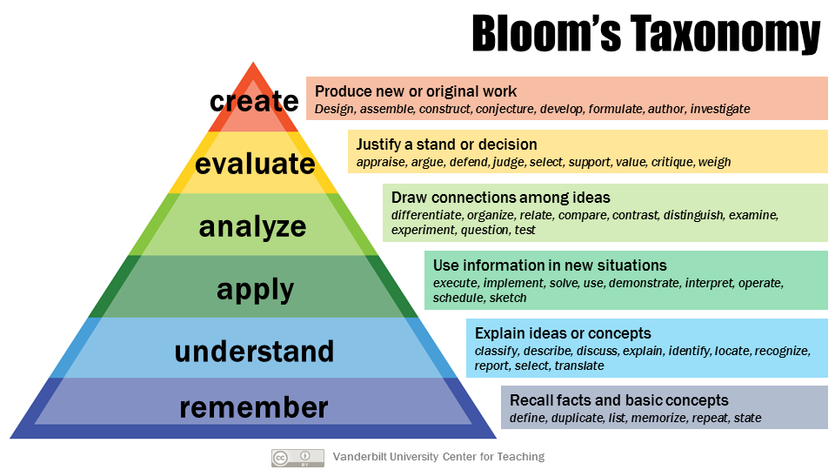
Approaches that help

Slide 7
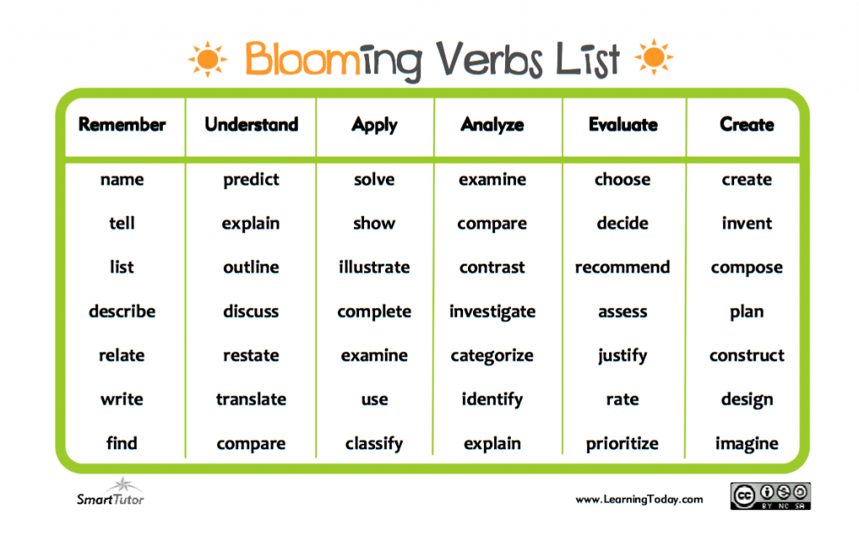
Words for Bloom‘s Taxonomy

Slide 8
SWBAT – students will be able to…
SWBAT name
SWBAT predict
SWBAT complete
SWBAT categorize
SWBAT recommend
SWBAT create

Slide 9
Some Terms & methods 1
Animation: create pictures (video, computer animation, …)
Anticipation: predict what the lesson is to be about
Blog: write your opinion for a post in the net (create)
Exploratory talk: discussing topics – teachers & students
Glossary: list of important words for a lesson
Hot seat: communicative role-play activity, e.g. adopt role of an expert and respond to questions of the class
Loop or domino game: matching pictures + definitions
Mind map
Podcast: listen to or create your own podcast

Slide 10
Some terms & methods 2
Shared writing: students complete a text/sentence
Visual organisers: Carroll diagram, cycle, flow diagram/chart, grid, key, mind map, cause-effect diagram, storyboard, table, tree diagram, venn diagram – to present results

Slide 11
CLIL 2
Content and language integrated learning

Slide 12
Best Practice, Ideas, Methods
CLIL Unterrichtsbeispiele – CEBS – Center für berufsbezogene Sprachen
Schauen Sie sich eines der Beispiele für die Unterrichtsvorbereitung in Partnerarbeit genau an
Entwerfen Sie eine eigene Unterrichtsplanung auf der Basis dieses Beispiels.
Probieren Sie eine der Learning Apps, die auf dieser Homepage angeführt sind, aus und erstellen Sie mit einer dieser Learning Apps eine Aufgabe für Ihr Unterrichtsfach.

Slide 13

LISTENING
A phone call from a customer | LearnEnglish (britishcouncil.org)
BBC Learning English - Lingohack / Flying car
Find a listening exercise either from britishcouncil.org or BBC Learning English which is suitable for your subject.
Prepare this exercise for one of your lessons. How do you introduce it? Which exercises can you do? Can you use the exercises given?
3 ways to motivate active listening for your students (clilmedia.com)
Find a text you could use in one of your lessons.
Prepare a listening activity for your students.

Slide 14

Writing and presenting a pitch
How To Create the Perfect Elevator Pitch in 6 Steps | Indeed.com
Create your own pitch
For your subject
For CLIL
About yourself

Slide 15
Creating an elevator pitch:
Sich selbst vorstellen (Jobbewerbung)
Den eigenen Unterrichtsgegenstand vorstellen
Einen Themenbereich präsentieren
Ein Projekt vorstellen
Schritte:
Die wichtigsten Informationen geben (bei Vorstellung der Person Infos aus Vergangenheit)
Die momentane Lage/Situation/ Wissensstand/Forschungsstand beschreiben
Ausblick auf die Zukunft geben „Call for action“
Gesamtdauer: 1-2 Minuten
Audio aufnehmen – oder Video

Slide 16
Interview with an expert
Find 5 questions for an expert – try it out with your fellow students:
Write down 5 questions.
Carry out the interview.
Record the interview with your smartphone.
Present the interview to your fellow students.

Slide 17
Back to the future
https://youtu.be/ArpvXxGYNSw
Create a video for your subject
“BACK TO THE FUTURE”

